Slide 1

YouTube Data Analysis
Team - The Fantastic Five
11.1.2022

Slide 2

Meet the team
Yuteng Zhang
Statistical Analysis
Dipti Sontakke
Presentation, Data Analysis
Alejandro Gutierrez
Data Intake, Data Cleaning
Patrick Brennan
Data Intake, Data Cleaning
Daniel King-Alan
Project Manager

Slide 3
Agenda
INTRODUCTION
PROJECT DESCRIPTION
ANALYSIS
CONCLUSION
REFERENCES

Slide 4

INTRODUCTION : What we have achieved
YouTube is common thread for many social media users around the globe. Our projects focuses on analysis of views, likes and comments based on Country and Category.
Our analysis focuses on answering below questions:
Is there a significant difference in the average like count of the top 50 videos within each designated region within YouTube?
H_{a}: Average like count will be significantly different between the regions
H₀: There is no difference between the average like count by region
Is there a significant difference in the average like count of the top 50 videos of each designated category within YouTube?
H_{a}: Average like count will be significantly different between the categories
H₀: There is no difference between the average like count by category
Additional Correlations: What is the average percent of videos liked by the number of views they have received?

Slide 5

Why YouTube Dataset? Let’s Dive In
YouTube’s API falls under the umbrella of the suite of APIs offered by Google, allowing us to make use of the Google API library for easier access
We retrieved data from two of the ‘Resources’ the YouTube API offers, Regions and Videos
From Regions, we pulled 109 country names and their IDs
From Videos, we pulled counts for likes, views, and comments for the top 50 videos by each country
The API only allows us to call a maximum of the 50 most popular videos by country for the day the call is made, essentially a screenshot in time
As we will see, this can create for interesting results in the countries with the most views on their most popular videos

Slide 6
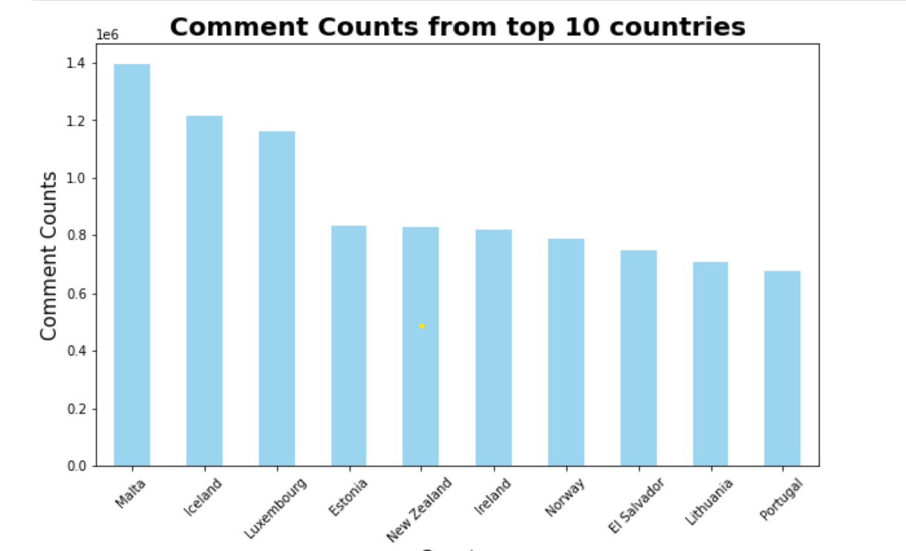
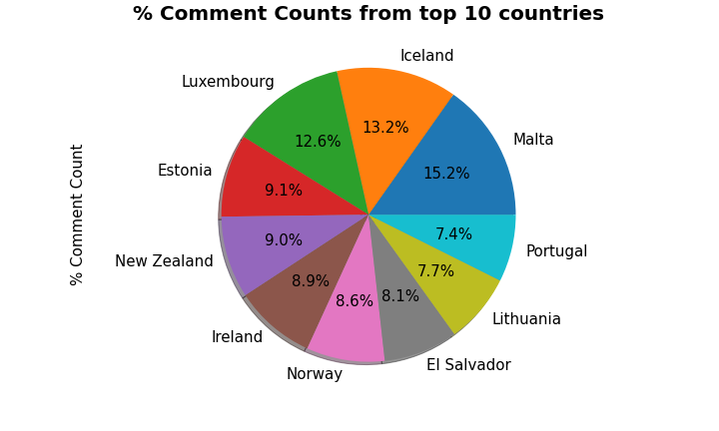
Comment counts from top 10 Countries
Distribution of comment counts per million by countries.
Distribution of percent of comment counts from top 10 countries.
The top 10 countries listed here and in the following slides are not the ones we may expect to see based off population size, but this is a results of the limitations of the API data calls.
One could theorize that these countries have more concentrated viewing focused on their top 50 videos than other countries, or the categories of video they watch are more broadly popular.

Slide 7
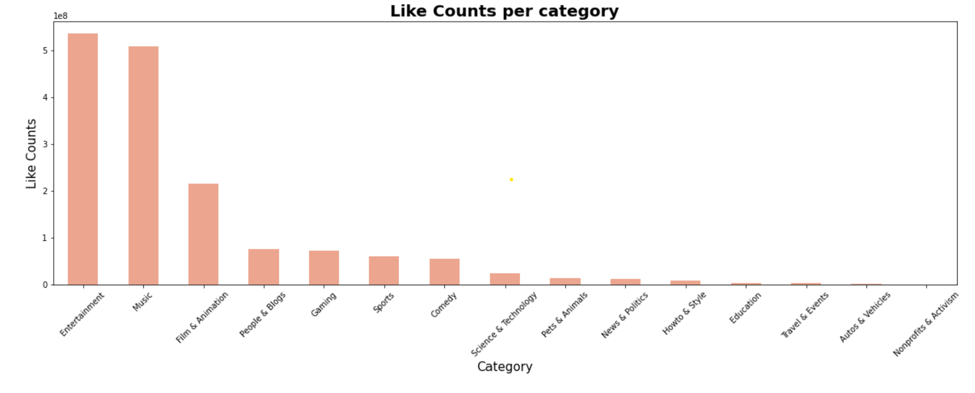
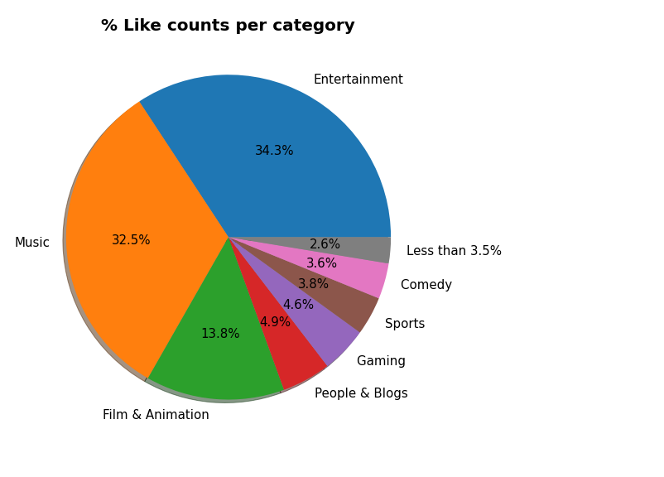
Likes counts from all categories
Distribution of likes counts per hundred million by category.
Distribution of percent of likes counts from all category.

Slide 8
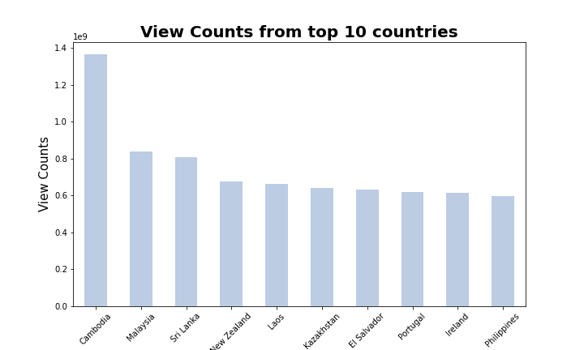
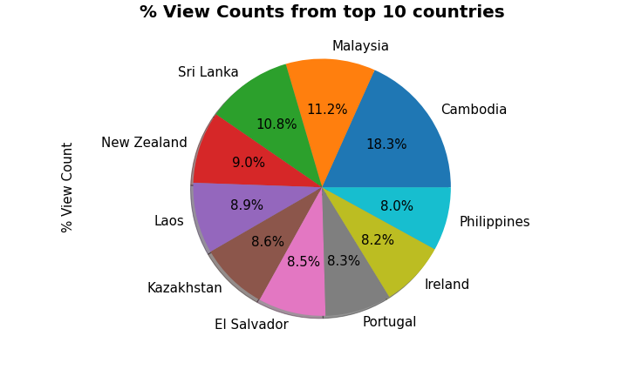
View counts from top 10 Countries
Distribution of view counts per billion by country.
Distribution of percent of view counts for top 10 countries.

Slide 9
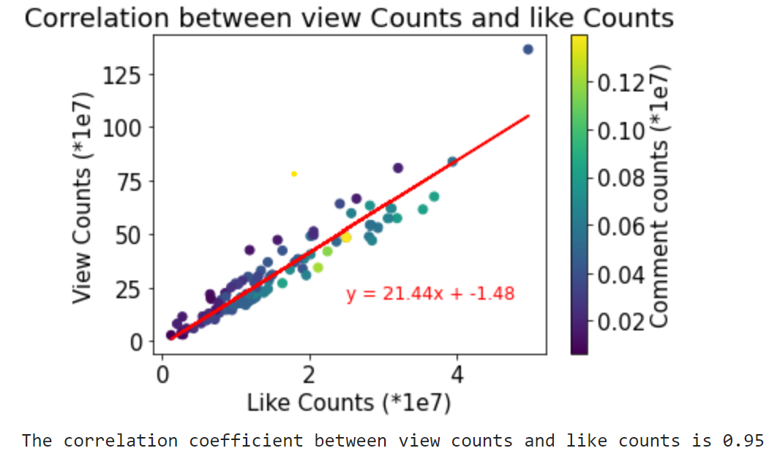
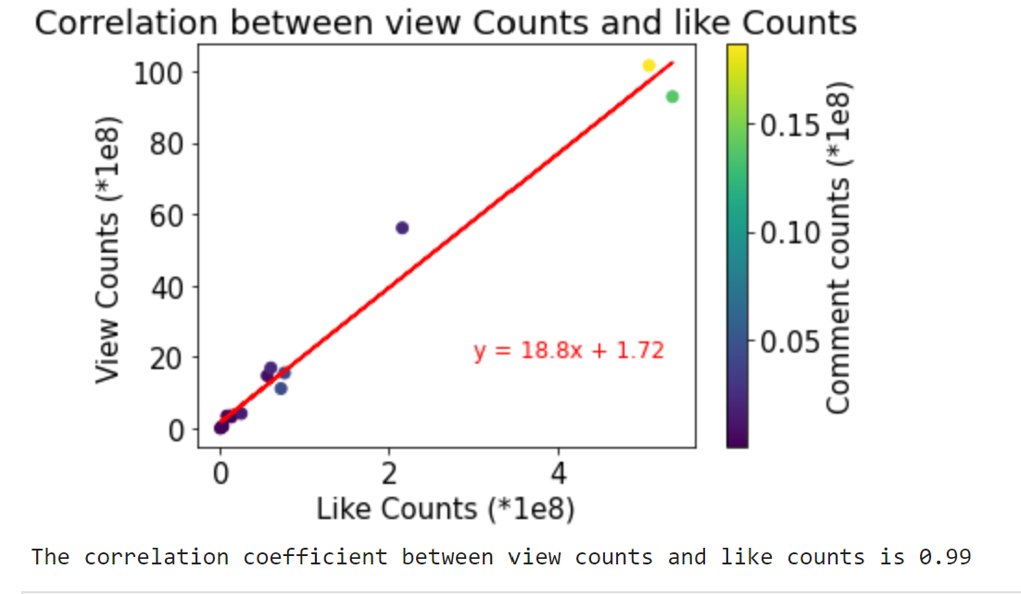
Correlation Analysis by country and category
Based on Country
Based on Category
View counts and like counts show us a strong positive correlation.
This correlation output is applicable for both country and category.

Slide 10
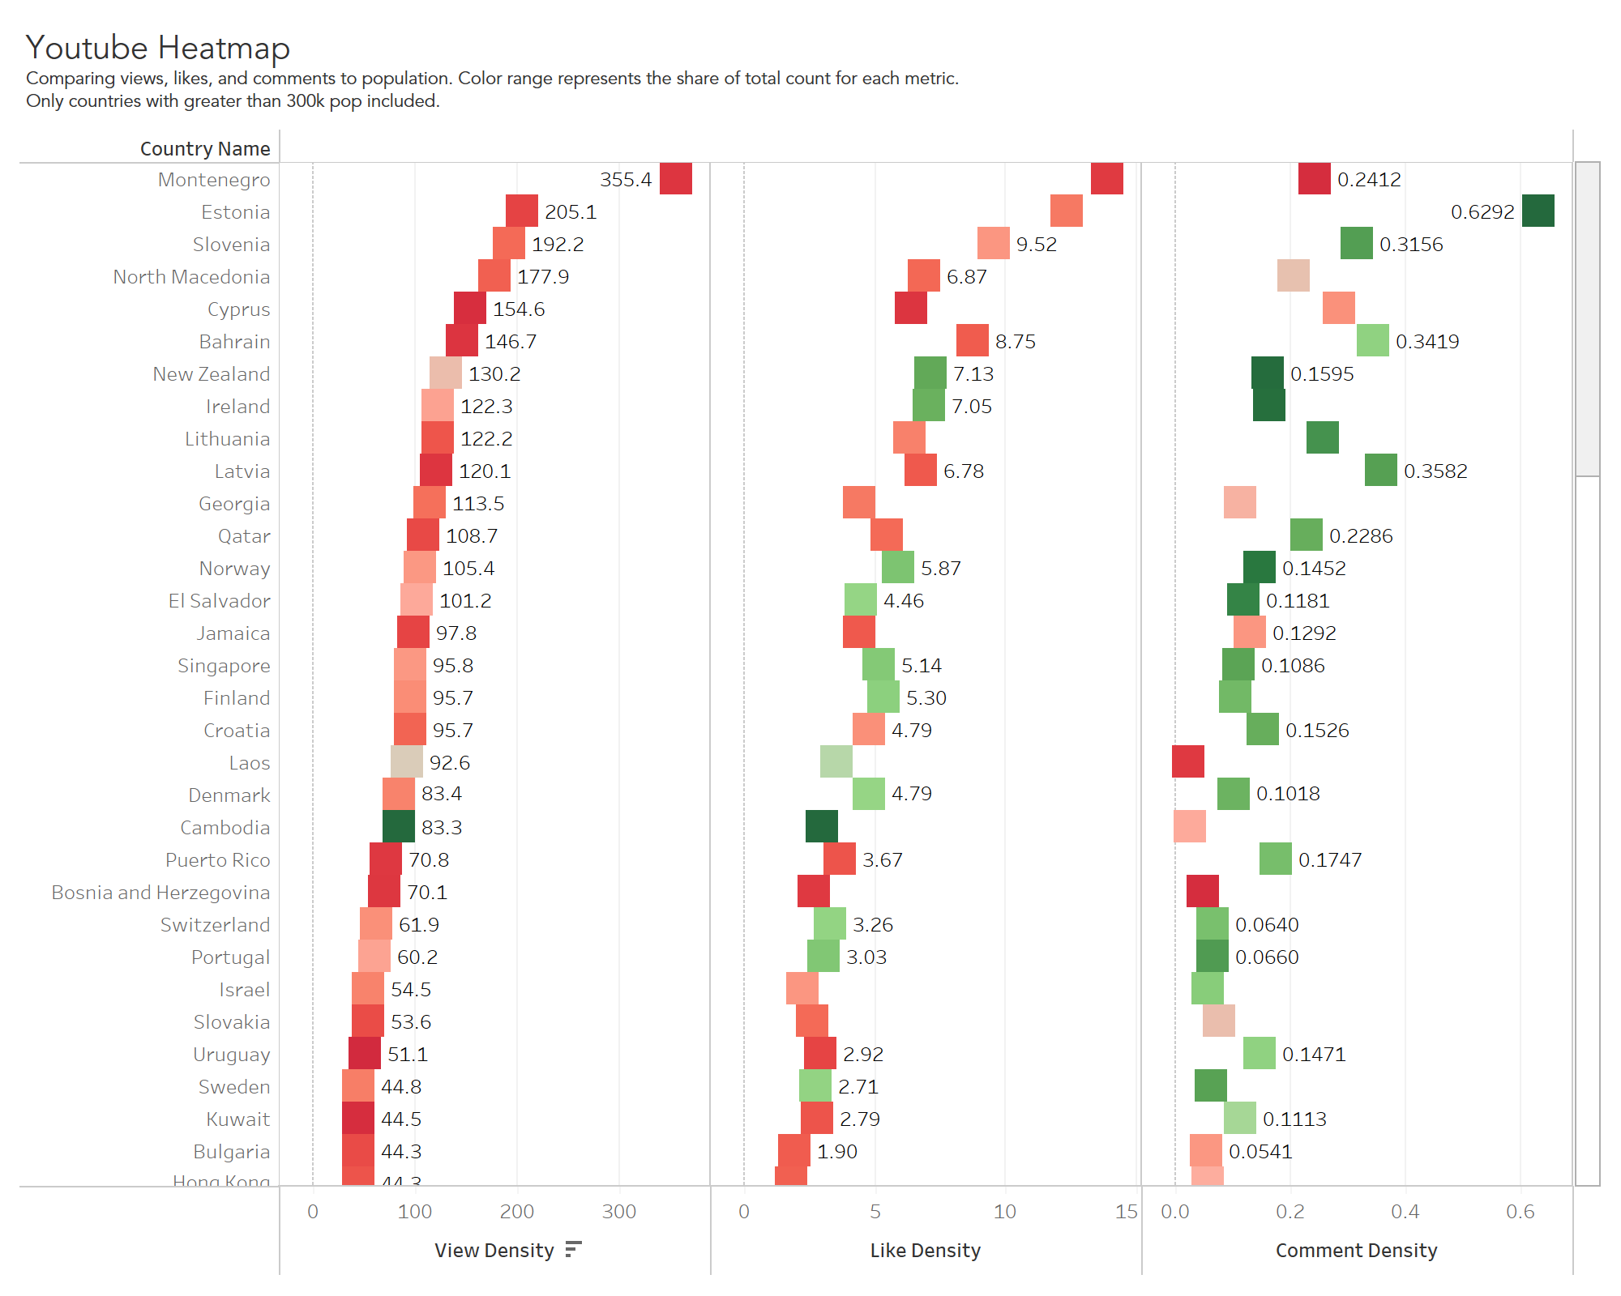
Heatmap – Comparing, Views Likes and Comments to population
heatmap purpose and its meaning and conclusion-

Slide 11
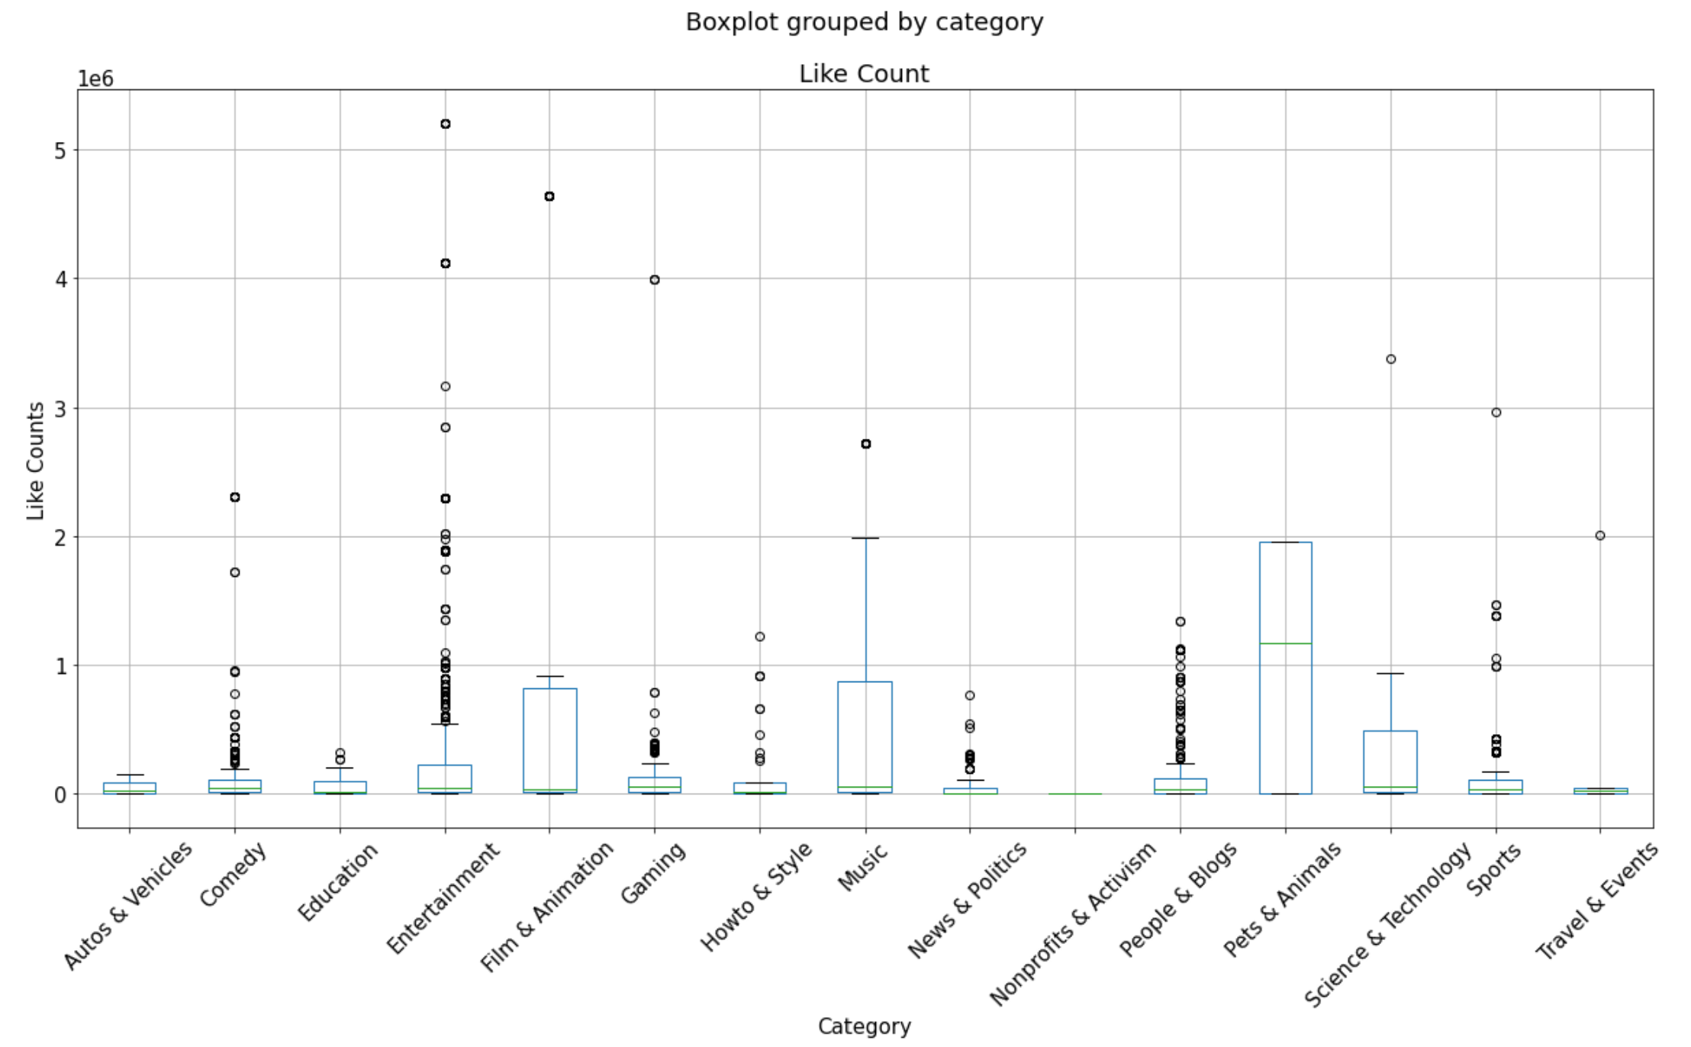
ANOVA Testing by Category
This is one way ANOVA test done by Category.
Also used t-test to determine if there is a significant difference between the mean of two groups. Also calculated p-value(2.9209956568816213e-94) is smaller than 0.05 indicates that the compared two groups do have significant difference.
The two groups compared: views vs comment; views vs likes and likes vs comments

Slide 12
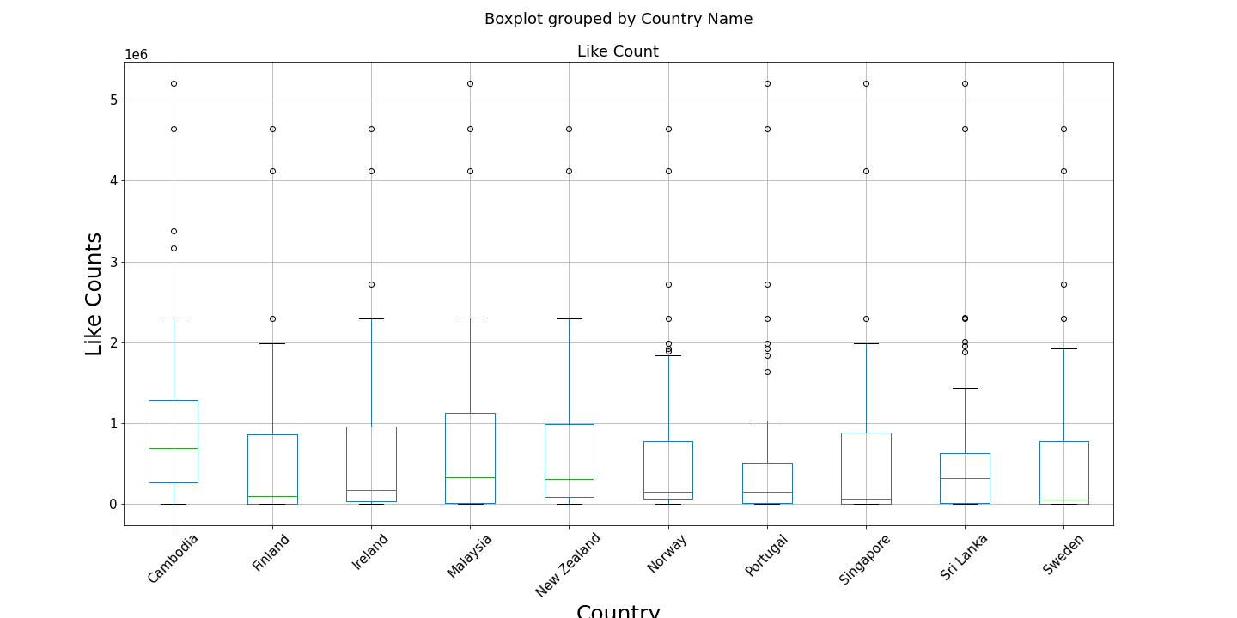
ANOVA Testing by top 10 country
This is one way ANOVA test doe by Category.
Also used t-test to determine if there is a significant difference between the mean of two groups. Also calculated p-value(7.403698275134119e-32) is smaller than 0.05 indicates that the compared two groups do have significant difference.
The two groups compared: views vs comment; views vs likes and likes vs comments

Slide 13
Conclusion
Accepting the findings as we have done ANOVA, t-test, and correlation coefficient that this Hypothesis testing is acceptable.
P-Value is less than 0.05 so we reject the null hypothesis and conclude that there are differences between regions and in their like counts and view counts.
P-Value is less than 0.05 so we reject the null hypothesis and conclude that there are differences between category and in their like counts and view counts.
Chances of getting more views, likes and comment counts from a video created for Music and Entertainment category is more compared to other categories such as DIY, Sports, News and Politics.
Music and Entertainment industry is in total has 65% more views compared to other categories.
Surprisingly, Cambodia has highest view count (approx. 14 billion) compared to other top country views. This may be due to Cambodian viewership being more highly concentrated in the top 50 most popular videos for that country.
As view count increases the like and comment counts also increases accordingly.
Top 5 countries that have the highest density of viewership are all located in Eastern or Southern Europe. It could indicate either cultural or socio-economic trend of those regions, or combination of both.
View count and view density showed different behaviors. From the top 10 countries for view count the majority were southeast Asian nations. Comparing this with view density a different pattern emerges where 9 of the top 10 countries were smaller European nations primarily in the Baltics and Balkans.

Slide 14

References
YouTube API - https://developers.google.com/youtube/v3
Python - https://pandas.pydata.org/
GitHub - https://github.com/PatttyCakess/Youtube-API-project

Slide 15
THANK YOU
Fantastic Five
https://github.com/PatttyCakess/Youtube-API-project
Georgia Tech – Boot Camp

